Slide 1
Coast Guard Recruiting
CG National Retiree Council
06 August 2024

Slide 2
FY 2024 – Reservations
Over 4,400 reservations for recruit companies throughout the year will yield over 4,200 accessions by the end of FY 2024
Will meet enlisted active-duty mission for first time since 2017
Projected to meet reserve recruiting mission of 725 in FY 2024. Up from 650 in FY 2023
Already commissioned 103% of target for ADPL officers in FY 2024
Will likely meet mission in all three metrics (enlisted active-duty, reserve, and officer) for first time since 2007
2

Slide 3
CG Recruiting Overview
While we have reached over 4200 reservations and accessions, there remains work to build capability to sustain long-term recruiting capacity.
Workforce projections show we need about 6,000 recruits (5,000 AD and 1,000 Reservists) to fill the CG’s current enlisted PAL in 5 years (does not account for billet growth).
Investments and efforts are starting to build positive momentum, but more work to be done and the environment remains extremely challenging.
Remain agile, visible, and leverage centers of influence to attract and recruit the best that our Nation has to offer.

Slide 4
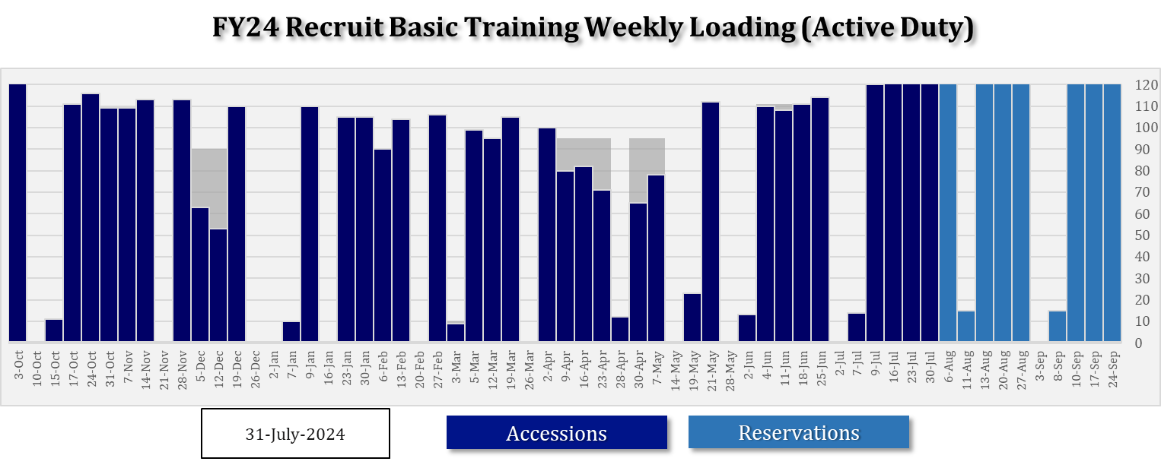
FY 2024 – Reservations Load Plan
4

Slide 5
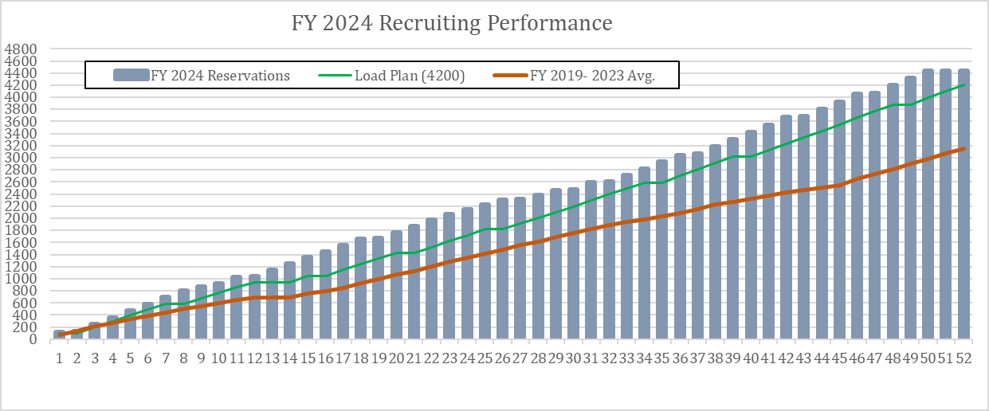
FY 2024 – Historical Comparison
5

Slide 6
Major Actions: Continuing to Advance New Initiatives
LOE 1: Generate More Leads
Virtual Recruiting/Call Center
Continue outreach to name from non-AI (ASVAB, Solomon Act, Event Leads, etc)
Protype use of AI-Generated Leads (Recruit 360)
Major Events Coordination
Develop & publish FY24 event list
Coordinate Major Events:
Field Engagement Support
Command Liaisons
STAR
Hometown Recruiting
Deliver promotional items to field
Special Projects:
NJCAA engagement - events ongoing
Improve & Increase Comms (internal & external)
Lateral Entry – Tech Schools
Delayed Decision Program
Partnership with USNCC
Fill ECHO Company
Lateral Entry – Contract Talent Scouts
‘Return to You’
LOE 2: Increase Performance and Capacity
Increase number of Recruiting Offices and Recruiters
Open & Staff new FY23 ROs
350 PRs + Prior Trained Recruiters online by summer
Open and Staff new FY24 RO
Revamp Recruiter Selection Process
Revamp Recruiter Incentive Program
Increase CGRC HQ Support Staff
Recruiter Performance Support
Contract Admin Support for Recruiting Offices
Contracted Medical Support (MEPS focused)
LOE 3: Improve Recruiting Processes
Establish Talent Acquisition Specialist Rating
Gangway
MEPS Improvements
Future Sentinel Prep Course

Slide 7
Investments to Continue Momentum
Modest recruiter and applicant incentives that deliver win-win-win outcomes for CG-Recruiter-Applicant investments can drive significant progress
Applicant Incentives:
Flexible utilization of quick ship bonuses and bonus stacking influences company fill rate
Over 100 applicants took advantage of the $20K to ship with the Dec 5th, 12th, 19th TCCM companies
Shipped 110 recruits on 19 Dec 2023
CG RC has MWPT support to provide similar flexibility for FY 2025
Recruiter Incentives:
~$211K resulted in finishing Q2 at 105% of our AD load plan & 95% of Reserve load plan
62% increase in accessions over FY 2023
Updated AIP approved by CG-1M increases opportunity for recruiters and includes checks for best Service results
7

Slide 8
Investments to Continue Momentum (con’t)
Marketing Efforts and Continued Expansion:
Expanded network of recruiting offices requires expanded marketing effort. Goal is $15-20M annually for Service brand awareness
Ad buys, support for major events, command liaison support, and increased marketing SWAG are necessary
New Office Locations and Detached Duty Billets:
Support for operational resources ($$ and FTE) will be vital to continued expansion efforts to reach 500 PRs and 85 ROs
CG RC Support Staff:
HQ Divisions
MEPS
Officer Recruiters
8

Slide 9
Potential Policy Changes
Changes to Tattoos
Recent update to service tattoo policy was significant first step but alignment with DoD services on hand and neck tattoos would increase accessions
ADHD Medication
Updates to DoD standards adopted by USCG have decreased denials for service but continued refinement as more applicants have history of medication will impact accessions timelines
Facial Hair
Service wide impact for recruiting and retention
First-mover advantage is real for this policy adoption related to impact on recruiting against other services
Willingness to iterate at speed is key to continued positive results
9

Slide 10
How You Can Continue to Help
Share our story with your community/network.
Explain how vital our recruiting effort is to our ability to execute the missions they rely on the CG to conduct.
Inform the community that the CG is a unique branch of the military: that we Protect the Environment, Save Lives, and Defend the nation from maritime threats.
Encourage community and business leaders to speak positively about the Coast Guard as an organization and a premier employer of choice that can help with national challenges in homeland, maritime, and national security.
Encourage fellow retirees to support recruiting efforts.
Inform them that we are still in a recruiting crisis and how that affects their CG.
Promote opportunities for them to volunteer and engage in local communities.
Inform them about the STAR program.
Encourage them to wear CG branded clothing.
Direct interested applicants to a local Recruiting Office.

Slide 11
Fleet Week New York & NJCAA Softball World Series

